Slide 1
Business Intelligence Concepts, Tools, and Applications
Week 1: Decision Making and Decision Support Systems
Lesson 2: Conceptual Foundations of Decision Making

Slide 2
Conceptual Foundation of Decision Making
Learning Objectives
Understand the decision styles and rationality of decision makers
List the four stages of Simon’s decision making process
Identify common strategies and approaches of decision makers
Notes:
Objectives of the decision makers supporting disciplines, styles, and how they relate to the personal characteristics of the decision maker, and the nature of group involvement in the decision (if any)
Rationality of the decision maker. A decision maker should not simply apply IT tools blindly. Rather, the decision maker gets support through a rational approach that simplifies reality and provides a relatively quick and inexpensive means of considering various alternative courses of action to arrive at the best or a good solution to the problem.
Simon’s decision making process
Common strategies and approaches for decision makers

Slide 3
Decision Styles of decision makers
Perceptive versus Receptive
Heuristic versus Analytic
Autocratic Versus Democratic
Consultative (with individuals or groups)
Notes:
From SHARDA, RAMESH; DELEN, DURSUN; TURBAN, EFRAIM, BUSINESS INTELLIGENCE AND ANALYTICS: SYSTEMS FOR DECISION SUPPORT, 10th Edition, © 2015. Used by permission of Pearson Education, Inc., New York, NY. All Rights Reserved.
For a computerized system to successfully support a manager, it should fit the decision situation as well as the decision style. Therefore, the system should be flexible and adaptable to different users (individuals vs. groups). The ability to ask what-if and goal-seeking questions provides flexibility in this direction. A Web-based interface using graphics is a desirable feature in supporting certain decision styles. If a DSS is to support varying styles, skills, and knowledge, it should not attempt to enforce a specific process. Rather, it should help decision makers use and develop their own styles, skills, and knowledge.

Slide 4
Common approaches of decision makers
Left-brain approach
Right-brain approach
Accommodating
Integrated
Source: Sauter, V. L. Intuitive Decision-Making, Communications of the ACM, 42(6), June 1999, page 109-115.
Notes:
Source: Sauter, V. L. Intuitive Decision-Making, Communications of the ACM, 42(6), June 1999, page 109-115.

Slide 5
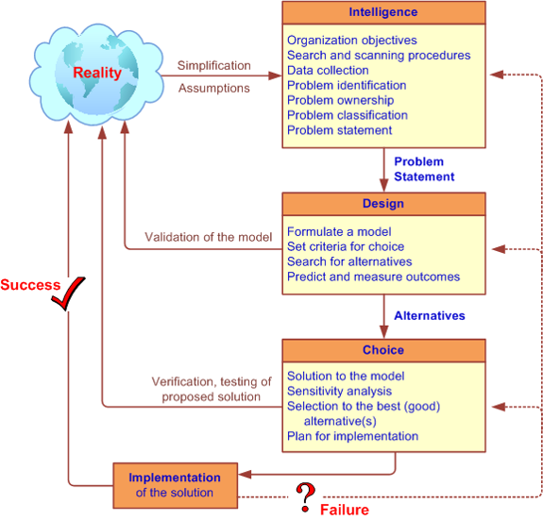
Simon’s Decision-Making Process
From SHARDA, RAMESH; DELEN, DURSUN; TURBAN, EFRAIM, BUSINESS INTELLIGENCE AND ANALYTICS: SYSTEMS FOR DECISION SUPPORT, 10th Edition, © 2015. Used by permission of Pearson Education, Inc., New York, NY. All Rights Reserved.
Notes:
Source: Sharda, R. Delen, D. , and Turban , E., Business Intelligence and Analytics: Systems for Decision Support, 10 ED, 2015, page 43.

Slide 6
Decision Making Process Intelligence Phase
Problem Identification
Problem Ownership
Problem Classification
Classification of problems according to the degree of structuredness
Problem Decomposition
Often solving the simpler sub-problems may help in solving a complex problem.
Information/data can improve the structuredness of a problem situation
Outcome of intelligence phase is a formal problem statement
From SHARDA, RAMESH; DELEN, DURSUN; TURBAN, EFRAIM, BUSINESS INTELLIGENCE AND ANALYTICS: SYSTEMS FOR DECISION SUPPORT, 10th Edition, © 2015. Used by permission of Pearson Education, Inc., New York, NY. All Rights Reserved.
Notes:
From SHARDA, RAMESH; DELEN, DURSUN; TURBAN, EFRAIM, BUSINESS INTELLIGENCE AND ANALYTICS: SYSTEMS FOR DECISION SUPPORT, 10th Edition, © 2015. Used by permission of Pearson Education, Inc., New York, NY. All Rights Reserved.

Slide 7
Decision Making Process Intelligence Phase
Scan the environment, either intermittently or continuously
Identify problem situations or opportunities
Monitor the results of the implementation
Notes:
From SHARDA, RAMESH; DELEN, DURSUN; TURBAN, EFRAIM, BUSINESS INTELLIGENCE AND ANALYTICS: SYSTEMS FOR DECISION SUPPORT, 10th Edition, © 2015. Used by permission of Pearson Education, Inc., New York, NY. All Rights Reserved.

Slide 8
Decision Making Process Design Phase
Determine alternatives
Finding/developing and analyzing possible courses of actions
Predict and measure outcomes
A model of the decision-making problem is constructed, tested, and validated
Notes:
From SHARDA, RAMESH; DELEN, DURSUN; TURBAN, EFRAIM, BUSINESS INTELLIGENCE AND ANALYTICS: SYSTEMS FOR DECISION SUPPORT, 10th Edition, © 2015. Used by permission of Pearson Education, Inc., New York, NY. All Rights Reserved.

Slide 9
Decision Making Process Choice Phase
Making the actual decision and the commitment to follow a certain course of action
Search
Evaluation
Recommendation
Notes:
From SHARDA, RAMESH; DELEN, DURSUN; TURBAN, EFRAIM, BUSINESS INTELLIGENCE AND ANALYTICS: SYSTEMS FOR DECISION SUPPORT, 10th Edition, © 2015. Used by permission of Pearson Education, Inc., New York, NY. All Rights Reserved.

Slide 10
Decision Making Process Choice Phase
Search approaches
Analytic techniques (solving with a formula)
Algorithms (step-by-step procedures)
Heuristics (rule of thumb)
Blind search (truly random search)
Model manipulation
Sensitivity analysis
What-if analysis
Goal seeking
Notes:
From SHARDA, RAMESH; DELEN, DURSUN; TURBAN, EFRAIM, BUSINESS INTELLIGENCE AND ANALYTICS: SYSTEMS FOR DECISION SUPPORT, 10th Edition, © 2015. Used by permission of Pearson Education, Inc., New York, NY. All Rights Reserved.

Slide 11
Rationality of decision makers
Principle of choice
is a criterion that describes the acceptability of a solution approach
In a model, it is a result variable
Normative and Rational decision making
Optimization (normative models)
Sub-optimization (heuristic models)
Descriptive decision making (simulation models)
Notes:
From SHARDA, RAMESH; DELEN, DURSUN; TURBAN, EFRAIM, BUSINESS INTELLIGENCE AND ANALYTICS: SYSTEMS FOR DECISION SUPPORT, 10th Edition, © 2015. Used by permission of Pearson Education, Inc., New York, NY. All Rights Reserved.

Slide 12
Decision Making Process Implementation Phase
Implementation
the initiation of a new order of things,
the introduction of change;
putting a recommended solution to work
Issues
resistance to change,
degree of support of top management,
user training
Notes:
From SHARDA, RAMESH; DELEN, DURSUN; TURBAN, EFRAIM, BUSINESS INTELLIGENCE AND ANALYTICS: SYSTEMS FOR DECISION SUPPORT, 10th Edition, © 2015. Used by permission of Pearson Education, Inc., New York, NY. All Rights Reserved.

Slide 13
Common strategies of decision makers
Optimizing versus satisfying
Elimination-by-aspects versus incrementalism
Mixed scanning
Minimizing risk and uncertainty
Notes:
From SHARDA, RAMESH; DELEN, DURSUN; TURBAN, EFRAIM, BUSINESS INTELLIGENCE AND ANALYTICS: SYSTEMS FOR DECISION SUPPORT, 10th Edition, © 2015. Used by permission of Pearson Education, Inc., New York, NY. All Rights Reserved.

